Slide 1
Organ Systems

Slide 2
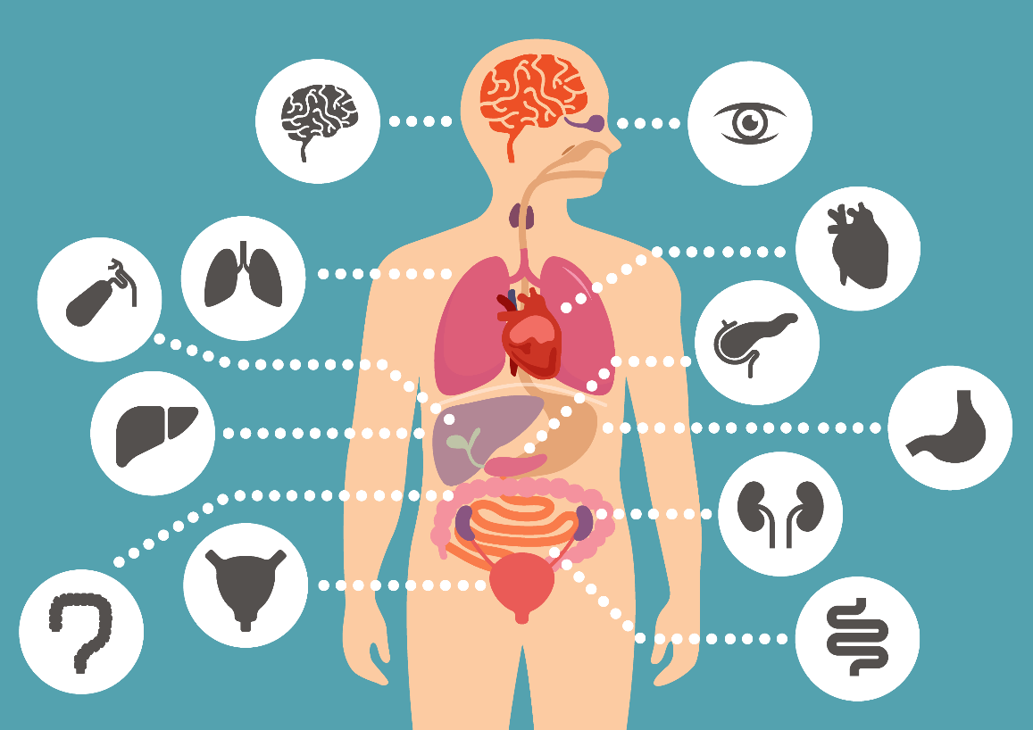
By the end of this lesson, you should be able to:
Describe what an organ system is.
Identify the main organ systems of the human body and explain their function.

Slide 3
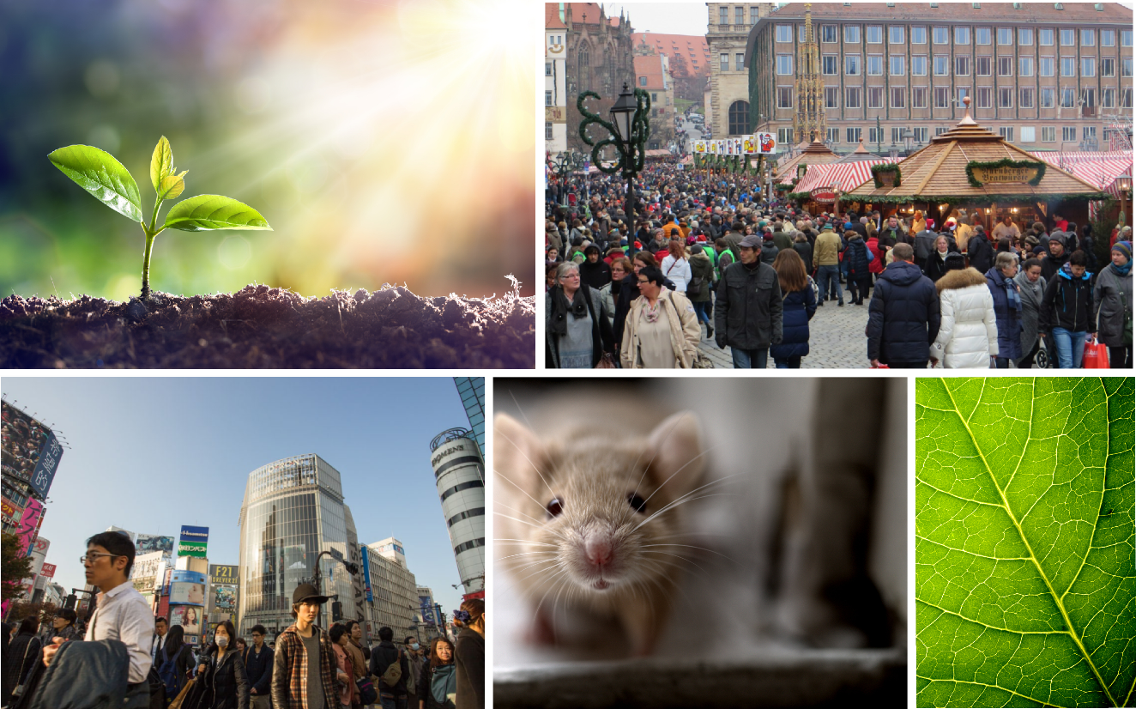
Did you know that you and other multicellular organisms are made up of a large number of organ systems?
Whether you are a human, plant or mouse, there are endless levels of organisation to keep the body functioning.
Organ systems are the final layer of organisation that together form the multicellular organism.

Slide 4
An organ system is a group of anatomical structures that work together to perform a specific function or task.
Mammals and other multicellular organisms have many organ systems. While we learn about each organ system as a distinct entity, the functions of the body's organ systems overlap considerably.
Organ systems allow you to digest your food, move your body, transport essential nutrients to every cell in your body and excrete waste.
Your own body could not survive without the cooperative functioning of all its organ systems. Typically, the failure of even one organ system can lead to severe disability or death.

Slide 5
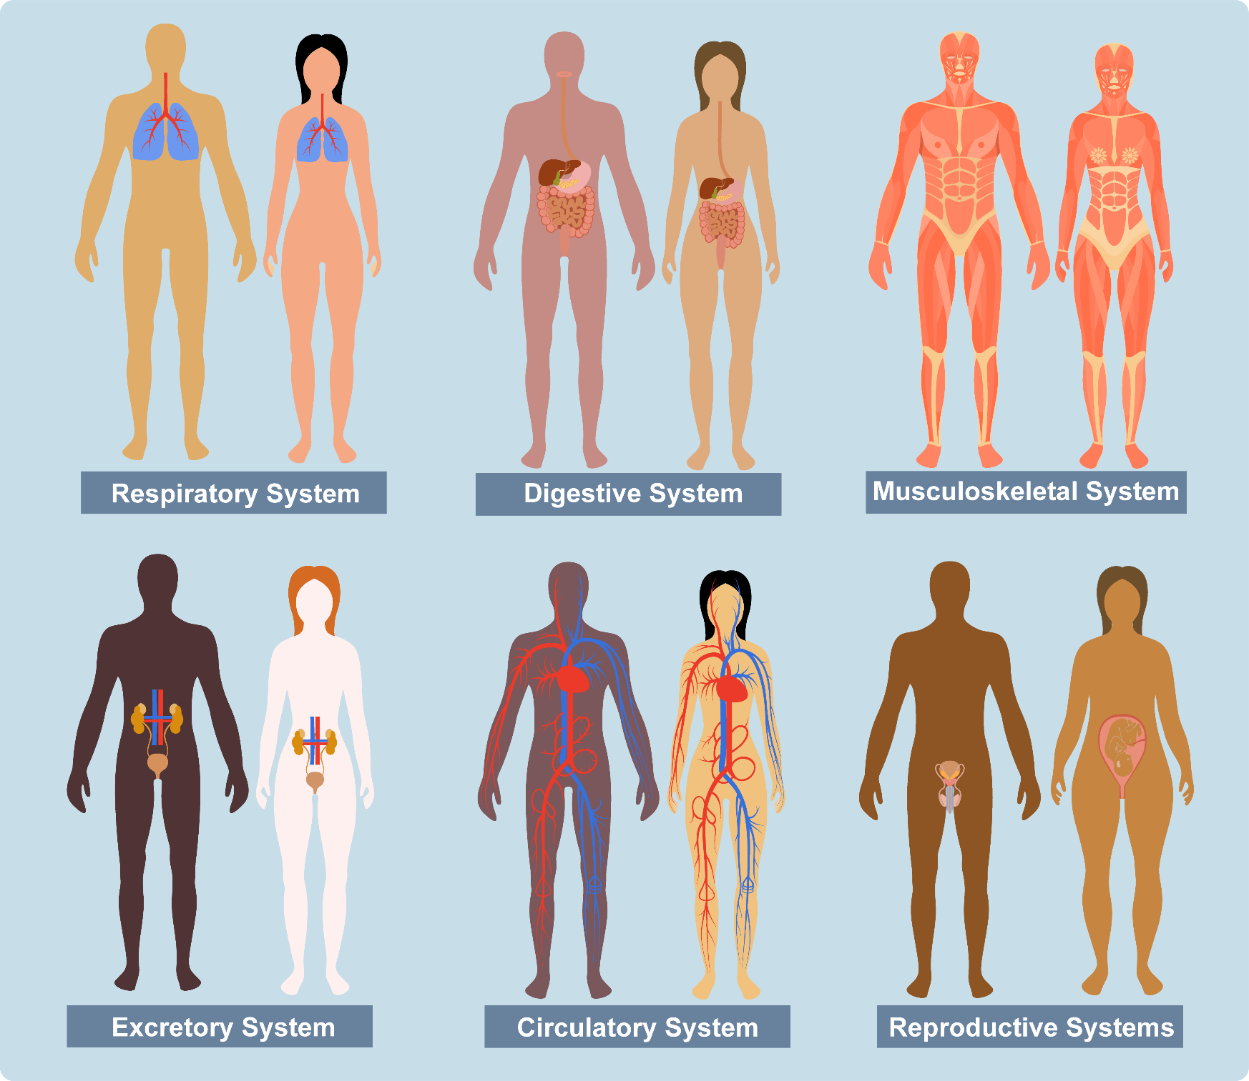

Slide 6
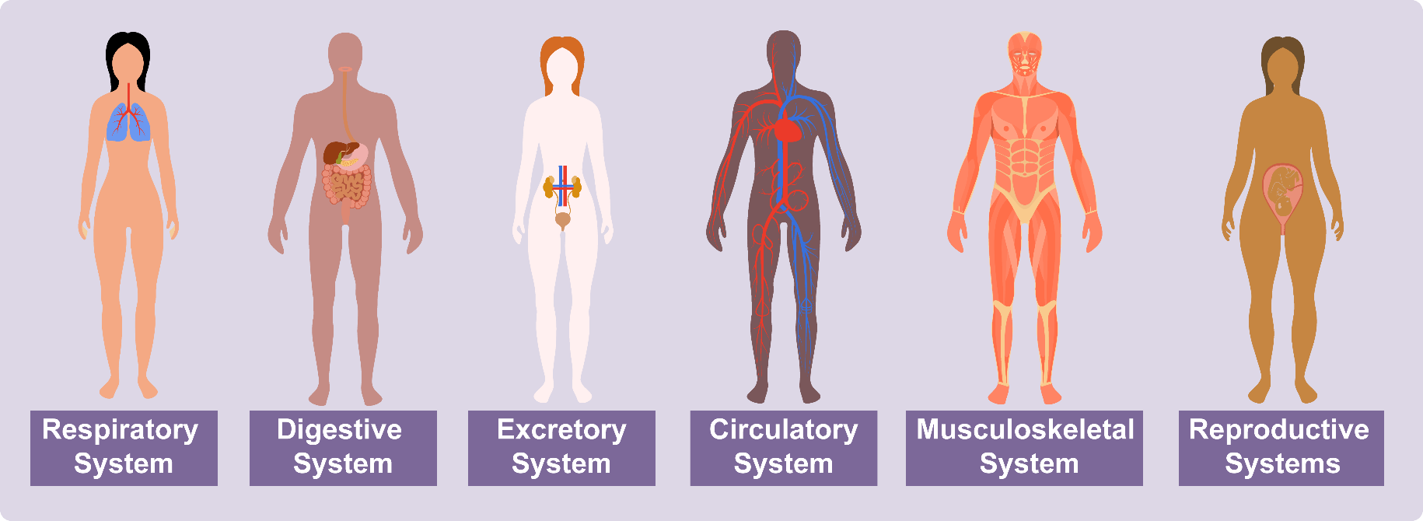
Multicellular organisms have many organ systems.
Luckily, in this module, you only need to be familiar with a few of them!
These are the:
Respiratory system
Digestive system
Excretory system
Circulatory system
Musculoskeletal system
Reproductive systems
In the upcoming information section we will learn more about each of these organ systems.

Slide 7
The human respiratory system is the organ system responsible for taking in oxygen and expelling carbon dioxide.
The respiratory system allows us to take in critical oxygen and expel carbon dioxide in a process we all know as breathing. The respiratory system works in tangent with the circulatory system to pump oxygen-rich blood to all of the cells in the body.
The primary organs of the respiratory system are:
The lungs: The site of gas exchange between the body and the external environment.
The pharynx (or throat): The 'tube' that connects the nose and mouth to the esophagus.
The diaphragm: The muscle that lies beneath the lungs and aids in inhalation and exhalation.

Slide 8
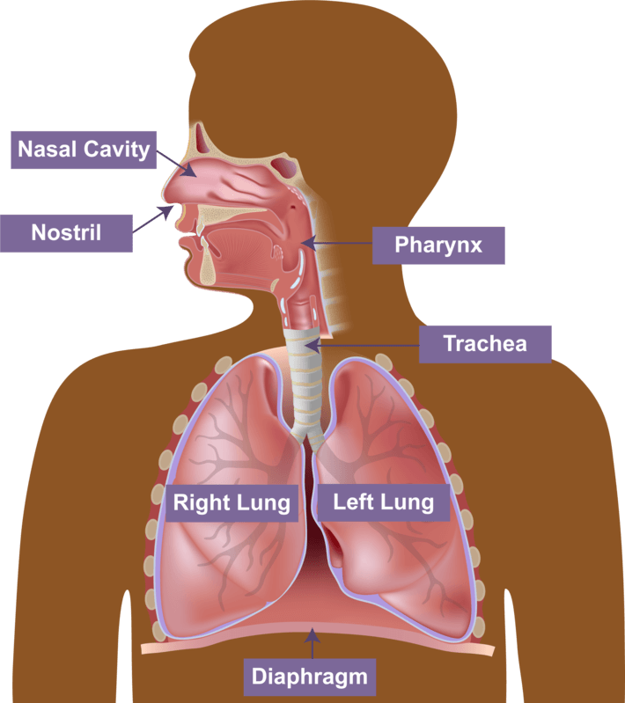
The process of breathing or respiration includes two main parts: external respiration and internal respiration. External respiration involves bringing air into the lungs (inhalation) and releasing air to the atmosphere (exhalation). In internal respiration, oxygen and carbon dioxide are exchanged between the cells and blood vessels.

Slide 9
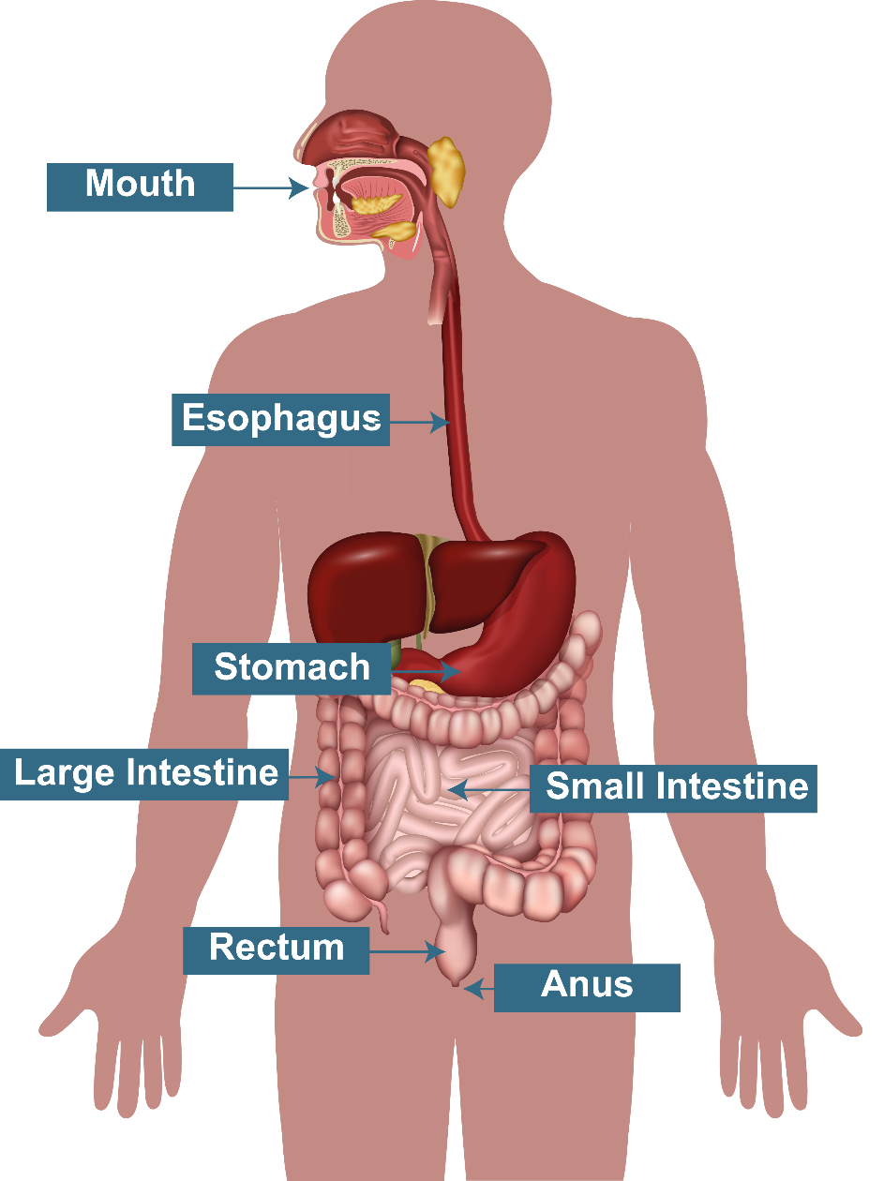
The digestive system is the organ system responsible for converting food into energy and nutrients to fuel the human body.
Essentially, the digestive system breaks down food into small molecules that can be used by cells in the body. This process is called digestion.
Digestion begins when food enters the mouth during eating. Mechanical and chemical digestion occurs in the mouth.
Mechanical digestion is where teeth grind and break up the food, while chemical digestion is where an enzyme in saliva chemically breaks down the food.
After the food is swallowed, this chewed food moves down the esophagus. The esophagus acts as a 'connection tube' between the mouth and stomach.
In the stomach, the chewed food undergoes further mechanical and chemical digestion. Digestion in the stomach occurs for several hours.

Slide 10
Food that has been digested in the stomach is then transported to the small intestine, where the majority of nutrient absorption occurs. The digested food that no further nutrients can be absorbed from it moves into the large intestine. This concentrated waste material is called faeces, which is passed into the rectum and then eliminated from the body through the anus.

Slide 11
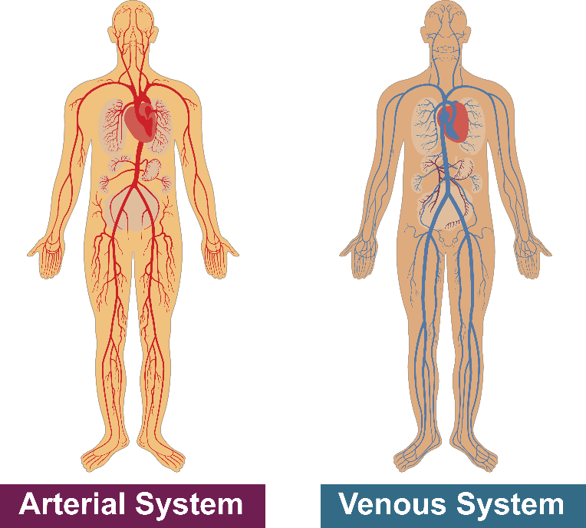
The circulatory system is responsible for carrying blood, nutrients, and waste throughout the body.
The human circulatory system consists of blood, blood vessels, and the heart. The heart is composed of specialised cardiac muscle that allows it to act as a pump within this system.
Blood is pumped throughout the human body via blood vessels.
Arteries (part of the arterial system) carry blood away from the heart into capillaries, providing oxygen and other nutrients to tissue and cells.
Once oxygen is removed, this blood travels back to the lungs to be reoxygenated via veins (part of the venous system).

Slide 12
The excretory system removes metabolic wastes from the body.
Metabolic wastes are substances left over from metabolic processes (i.e. cellular respiration) that cannot be used by the organism (as they are surplus or toxic). Therefore, this waste must be removed from the body.
The major organs of the excretory system are the kidneys, a pair of 'bean-shaped' organs below the liver. The kidneys filter blood and regulate water balance in the body.
The urinary tract (the ureters, bladder and urethra) is also a major part of the excretory system. It filters wastes and water from the blood, and eliminates them from the body in the form of urine.

Slide 13
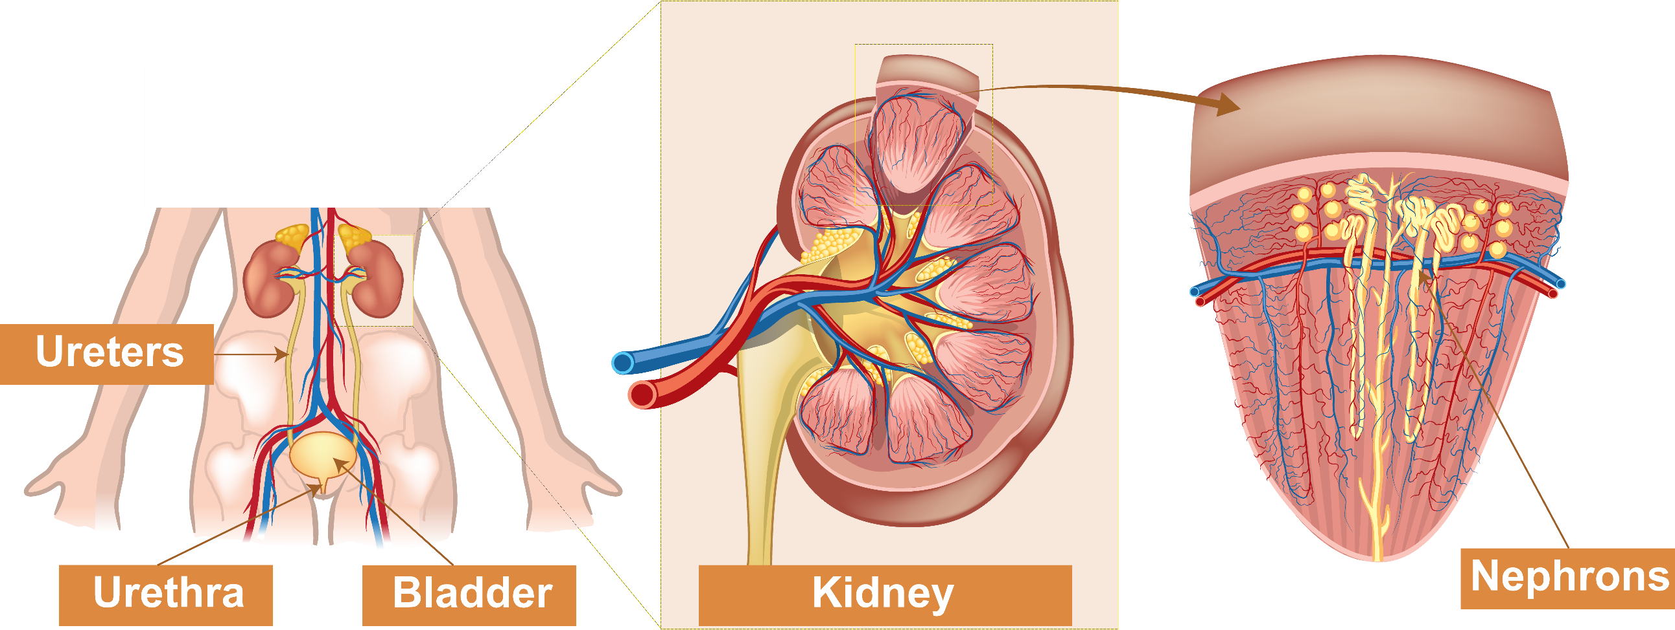
The kidneys produce the waste product urine using special functional units called nephrons. This process occurs in three steps:
Filtration: Blood enters kidney nephrons, which filters out impurities.
Reabsorption: These impurities move through tubules of the kidney, while the rest of the blood is reabsorbed through capillary walls back into the circulatory system.
Excretion: Urine is transported from the kidney through ureters to the bladder. Urine is then excreted from the bladder through the urethra.

Slide 14
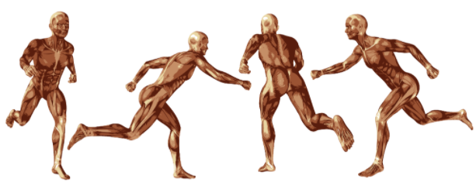
In the musculoskeletal system, the muscular and skeletal systems work together to support and move the body.
In the skeletal system, bones serve to protect the body's organs, support the weight of the body, and give the body shape.
The muscles of the muscular system attach to these skeletal bones, pulling on them to allow for movement of the body.

Slide 15
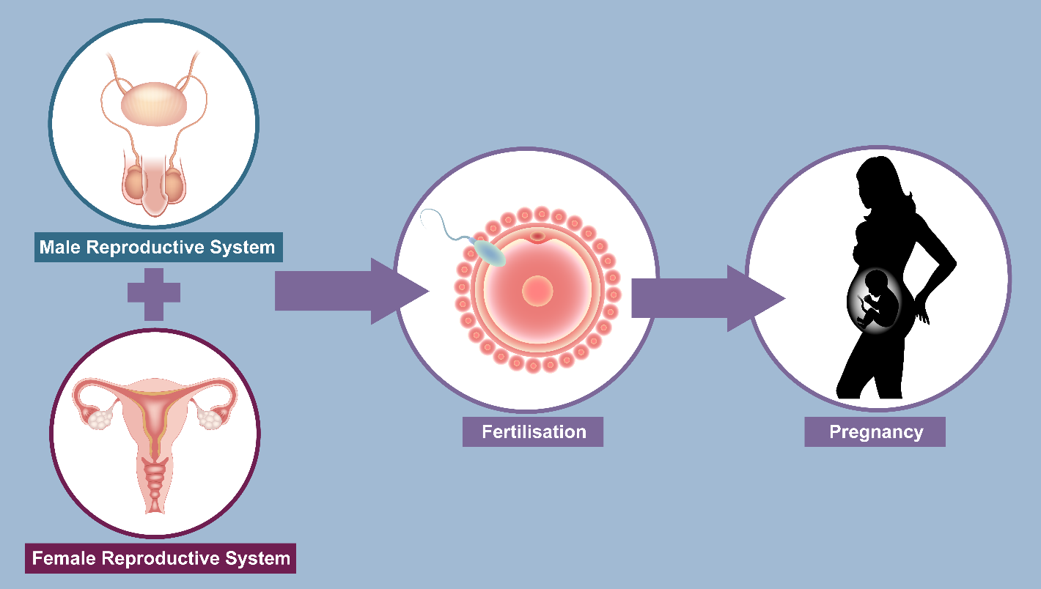
The reproductive systems are responsible for the production of offspring.
The female reproductive system consists of the ovaries (the female gonad or reproductive gland that produces ova and hormones), fallopian tubes, uterus, cervix and vagina.
The male reproductive system consists of the testes (the male gonad or reproductive gland that produces sperm and hormones), scrotum, seminal vesicle and penis.
Fertilisation, the fusion of a sperm and ovum to produce a zygote, during sexual reproduction occurs in the female fallopian tube.

Slide 16
